Slide 1

Normalization: An Essential Database Concept
Normalization is a fundamental technique in database design that organizes data in a database to reduce redundancy, improve data integrity, and optimize query performance. It involves breaking down a database into smaller tables and defining relationships between them.

Slide 2

What is Normalization?
1
Eliminating Redundancy
2
Improving Data Integrity
Normalization removes duplicate data by organizing information into separate, related tables.
Normalized databases ensure data consistency and reduce the risk of data anomalies.
3
Optimizing Performance
Normalization can improve query speed and efficiency by minimizing data duplication.

Slide 3
Objectives of Normalization
Eliminate Redundancy
Ensure Data Integrity
Optimize Performance
Reduce the storage of the same data in multiple places, which can lead to data inconsistency and excessive storage requirements.
Maintain the accuracy, completeness, and consistency of data by enforcing relationships and constraints.
Improve query speed and efficiency by minimizing the amount of data that needs to be accessed or transferred.

Slide 4

Normal Forms: 1NF, 2NF, 3NF, BCNF
1
1NF
Eliminates repeating groups and ensures data is stored in a tabular format with no nested tables.
2
2NF
Ensures that all non-key attributes are fully dependent on the primary key, not just a part of it.
3
3NF
Removes transitive dependencies, where a non-key attribute depends on another non-key attribute.
4
BCNF
Enforces that every determinant (a set of attributes that uniquely identifies a row) is a candidate key.

Slide 5
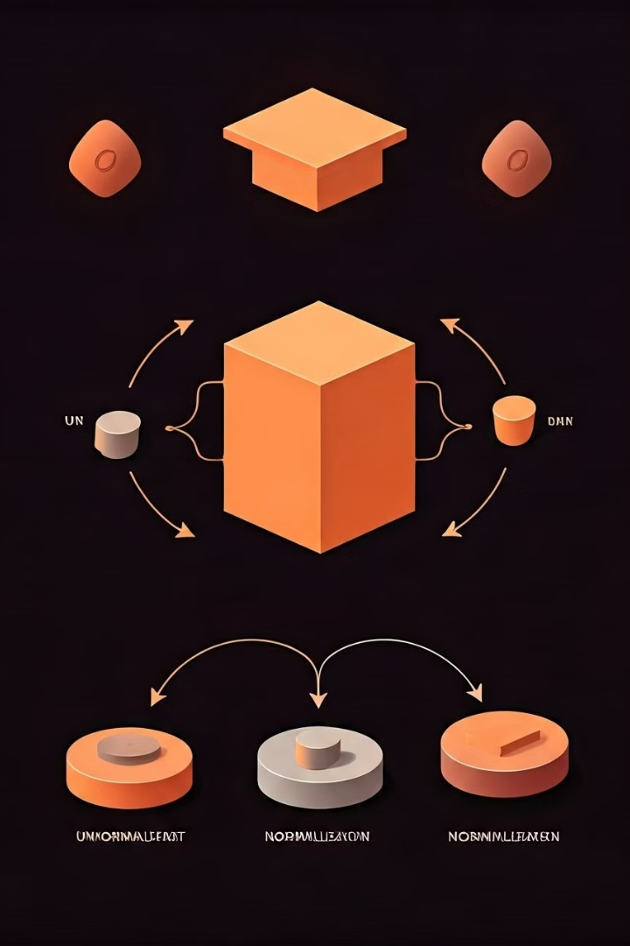




Applying Normalization: Step-by-Step
Identify Entities
Determine the key objects and their attributes that need to be represented in the database.
Define Relationships
Establish the connections between the entities, such as one-to-many or many-to-many.
Apply Normal Forms
Progressively normalize the database schema to eliminate redundancy and improve data integrity.
Validate and Iterate
Continuously review the normalized schema and make adjustments as needed.

Slide 6





Benefits of Normalized Databases
Reduced Redundancy
Improved Integrity
Enhanced Performance
Better Scalability
Normalized databases eliminate the storage of the same data in multiple places.
Normalization ensures data consistency and reduces the risk of data anomalies.
Normalization makes it easier to add, update, or remove data without affecting the overall database structure.
Normalized schemas can improve query speed and efficiency by minimizing data duplication.

Slide 7

Conclusion and Key Takeaways
1
Normalization is Essential
2
Balancing Tradeoffs
Carefully consider the balance between normalization and denormalization based on your specific requirements.
Applying normalization principles is a critical step in designing efficient and scalable databases.
3
Continuous Improvement
Regularly review and refine your database schema to maintain optimal performance and data integrity.

